Slide 1
EE227 – Digital Logic Design
Lecture 25

Slide 2
Outline
Registers
Registers with Parallel Load
Shift Registers
Serial Transfer
Serial Addition
Universal Shift Register

Slide 3
Types of Sequential Circuits
Circuits that include flip‐flops are usually classified by the function they perform rather than by the name of the sequential circuit
Two such circuits are
Registers
Group of flip flops capable of storing binary information
Counters
A counter is essentially a register that goes through a predetermined sequence of binary states

Slide 4
Registers
A register is a group of flip‐flops, each one of which shares a common clock and is capable of storing one bit of information
An n – bit register consists of a group of n flip‐flops capable of storing n bits of binary information
In addition to the flip‐flops, a register may have combinational gates that perform certain data‐processing tasks
In its broadest definition, a register consists of a group of flip‐flops together with gates that affect their operation
The flip‐flops hold the binary information, and the gates determine how the information is transferred into the register

Slide 5
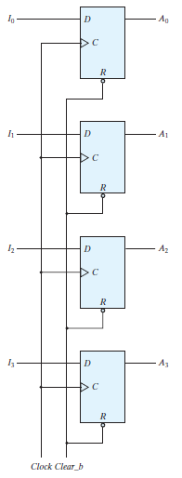
Simple 4 – Bit Register
A simplest register is a group of flip flops without any additional gates
All the flip flops share a common clock
A 4 – bit register is shown
At positive edge the inputs I₀, I₁, I₂ and I₃ are transferred to register
The outputs A₀, A₁, A₂ and A₃ can be sampled any time
The clear_b input is active low
When connected to logic 1 the register performs normal operation
When connected to logic 0 it clears all the bits (make all the output bits equal to 0)

Slide 6
Register with Parallel Load
Registers with parallel load are a fundamental building block in digital systems
A clock signal supplies the train of pulses
Another control signal will decide which operation will be performed
The transfer of new information into a register is referred to as loading or updating the register
If all the bits of the register are loaded simultaneously with a common clock pulse, we say that the loading is done in parallel
This can be done by applying a Clock pulse to clk input and a load input to all data inputs

Slide 7
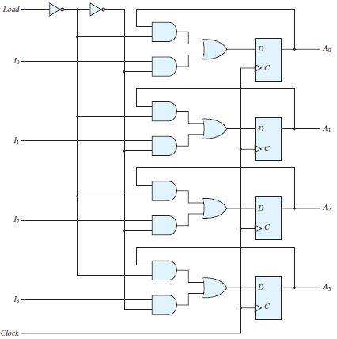
4 – Bit Register with Parallel Load
The additional gates are forming a 2 channel MUX
The load input to the register determines the action to be taken with each clock pulse
When the load input is 1, the data at the four external inputs are transferred into the register with the next positive edge of the clock
When the load input is 0, the outputs of the flip‐flops are connected to their respective inputs
The feedback connection from output to input is necessary because a D flip‐flop does not have a “no change” condition

Slide 8
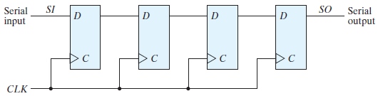
Shift Register
A register capable of shifting the binary information held in each cell to its neighboring cell, in a selected direction, is called a shift register
The logical configuration of a shift register consists of a chain of flip‐flops in cascade, with the output of one flip‐flop connected to the input of the next flip‐flop
The serial input determines what goes into the leftmost flip‐flop during the shift
The serial output is taken from the output of the rightmost flip‐flop

Slide 9
Serial Transfer (1/2)
The datapath of a digital system is said to operate in serial mode when information is transferred and manipulated one bit at a time
Information is transferred one bit at a time by shifting the bits out of the source register and into the destination register

Slide 10
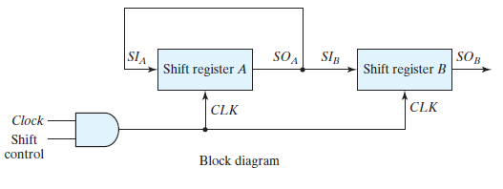
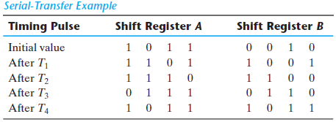
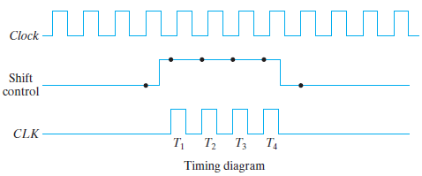
Serial Transfer (2/2)

Slide 11
Serial Addition
Operations in digital computers are usually done in parallel because that is a faster mode of operation
Serial operations are slower because a datapath operation takes several clock cycles,
But serial operations have the advantage of requiring fewer hardware components
Two 4 bit numbers can be added serially by following these steps
Two 4 – bit numbers are placed in 4 bit shift registers (A & B)
Bits are added starting from LSB
The sum bit is fed back to shift register A
The carry is placed in a 1 bit register and then fed to full adder

Slide 12
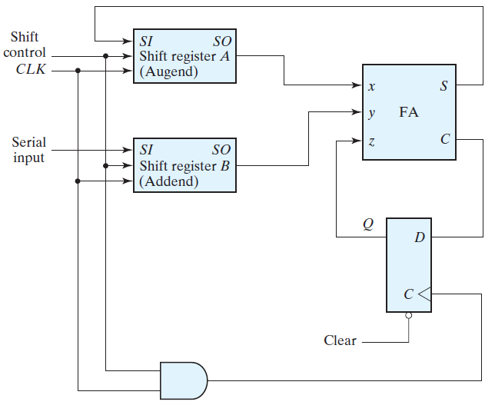
Serial Addition with D Flip Flop

Slide 13
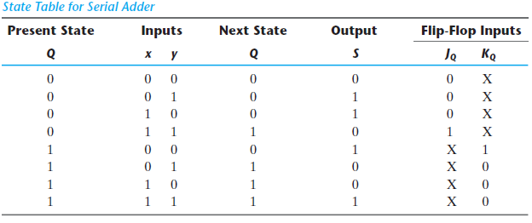
Serial Addition with JK Flip Flop (1/2)
J_{Q} = xy
K_{Q} = x’y’ = (x + y)’
S = x ⊕ y ⊕ Q

Slide 14
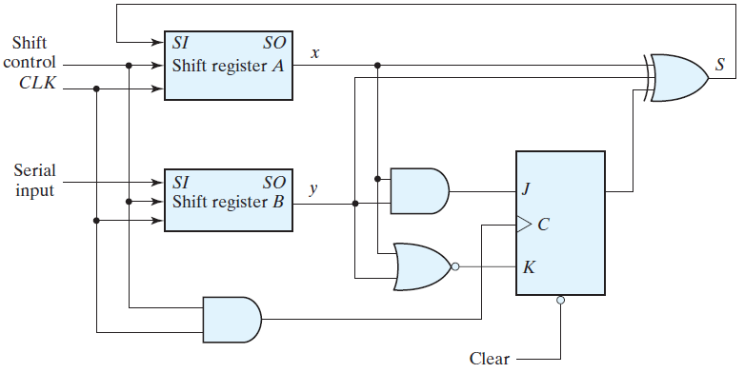
Serial Addition with JK Flip Flop (2/2)
J_{Q} = xy K_{Q} = (x + y)’ S = x ⊕ y ⊕ Q

Slide 15
Comparison of Serial and Parallel Adder
Comparing the serial adder with the parallel adder, we note several differences
The parallel adder uses registers with a parallel load, whereas the serial adder uses shift registers
The number of full‐adder circuits in the parallel adder is equal to the number of bits in the binary numbers, whereas the serial adder requires only one full‐adder circuit and a carry flip‐flop
Excluding the registers, the parallel adder is a combinational circuit, whereas the serial adder is a sequential circuit which consists of a full adder and a flip‐flop that stores the output carry
In serial adder the result depends on the present inputs, as well as on previous inputs that are stored in flip‐flops

Slide 16
Universal Shift Register
If the flip‐flop outputs of a shift register are accessible, then information entered serially by shifting can be taken out in parallel from the outputs of the flip‐flops
If a parallel load capability is added to a shift register, then data entered in parallel can be taken out in serial fashion by shifting the data stored in the register
A register capable of shifting in one direction only is a unidirectional shift register
One that can shift in both directions is a bidirectional shift register
If the register has both shifts and parallel‐load capabilities, it is referred to as a universal shift register

Slide 17
Capabilities of Universal Shift Register
A clear control to clear the register to 0
A clock input to synchronize the operations
A shift‐right control to enable the shift‐right operation and the serial input and output lines associated with the shift right
A shift‐left control to enable the shift‐left operation and the serial input and output lines associated with the shift left
A parallel‐load control to enable a parallel transfer and the n input lines associated with the parallel transfer
n parallel output lines
A control state that leaves the information in the register unchanged in response to the clock

Slide 18
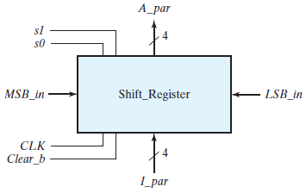
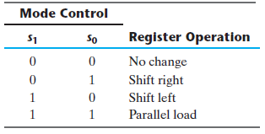
Operations of Universal Shift Register
A four bit universal shift register contains four 4-to-1 MUX and four D flip flops
Block diagram of a four bit universal shift register is shown below
There are two selection lines S₀ and S₁
The modes of operation are listed in the table below

Slide 19
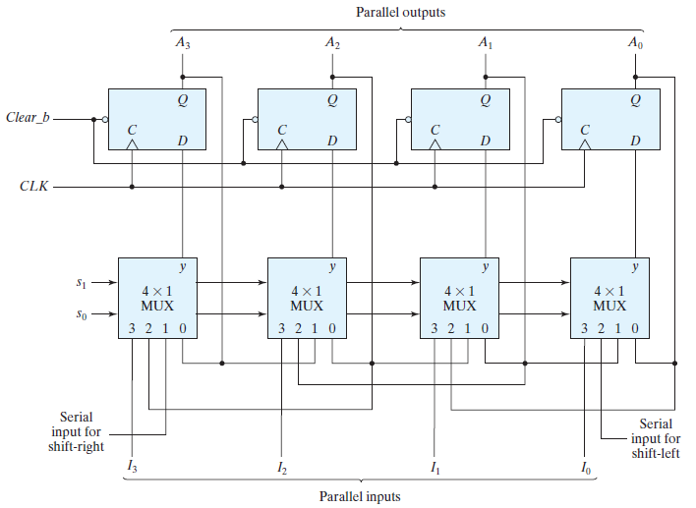
4 – Bit Universal Shift Register

